Slide 1
APL – The Advanced Physical Layer
Peter Thomas – HMS Networks Ltd
PI Training Manager (MU North)
Chairman PROFIBUS & PROFINET International Training Centre’s

Slide 2

APL – A game-changer for the Process Industry
For over 30 years, PROFIBUS PA has facilitated a fieldbus-based alternative to the long-established 4-20mA method of connecting field-based instrumentation to a centralised control system.
The Advanced Physical Layer, or APL, now provides a route of using Ethernet, instead of Profibus PA, to bring similar benefits to those achieved when migrating from PROFIBUS DP to PROFINET.
PI UK – Glasgow 2023 – APL The Advanced Physical Layer

Slide 3
PROFIBUS PA – Topology
PROFIBUS PA topologies generally follow a trunk line from which individual instruments are “T” off via using multi-port junction boxes or segment protectors
PA slave
PA slave
PA slave
PA slave
DP
PA slave
T
junction
boxes
DP/PA
T
PA slave
coupler
T
PA slave
Power
supply
PA slave
PA slave
PA slave
Termination
normally built in to coupler
Other termination
in last junction box (preferred position)
PI UK – Glasgow 2023 – APL The Advanced Physical Layer

Slide 4
PROFIBUS PA - Cabling
Every segment of a safe-area PROFIBUS PA network uses two-core twisted pair / screened cable to carry both power and data to each device.
The total length of cable in every safe-area segment must not exceed 1.9Km, including the lengths of the drops down to each instrument.
You can have up to 32 devices in a safe-area segment, but length drops can reduce this to as low as 12.
Construction | Shielded twisted pair
Conductor area | 0.8 mm²
Impedance | 100 Ω ±20% at a frequency of 31.25kHz
Loop Resistance | ≤ 44 Ω/ km
PI UK – Glasgow 2023 – APL The Advanced Physical Layer

Slide 5
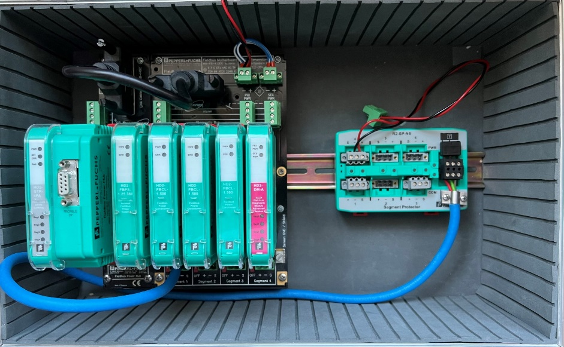
PROFIBUS DP/PA Couplers
Because PROFIBUS DP and PROFIBUS PA use two different electrical transmission systems, DP/PA couplers are required to convert from RS485 (DP) to Manchester Bus Power (PA).
DP/PA LINK
SEGMENT PROTECTOR
COUPLERS
Diagnostic Module
PI UK – Glasgow 2023 – APL The Advanced Physical Layer

Slide 6

PROFIBUS PA & HAZARDOUS AREAS
By default, PA devices and DP/PA couplers are for safe-area use only.
However as long as suitably-rated devices and couplers are used and specific rules relating to cable length and device count are followed, PROFIBUS PA can be used in Hazardous areas using EX ib or Ex ia. The limitations are:
Cable length limited to 1km
Length of drops to instruments limited to 60m
No of devices are typically limited to around 8 per segment (FISCO rules)
PI UK – Glasgow 2023 – APL The Advanced Physical Layer

Slide 7
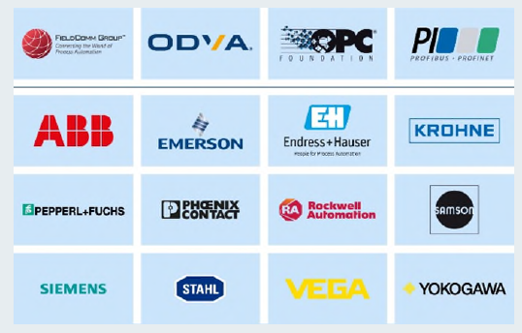
APL is not just a PI project
PI UK – Glasgow 2023 – APL The Advanced Physical Layer

Slide 8



APL and Ethernet
APL is completely standard Ethernet and differs only in its physical aspects. i.e. Layer 1 in the 7-layer OSI model.
Unlike PROFIBUS PA, which used the PROFIBUS DP protocol, APL is an open communications standard that supports standard TCP as well as several industrial ethernet protocols
PI UK – Glasgow 2023 – APL The Advanced Physical Layer

Slide 9
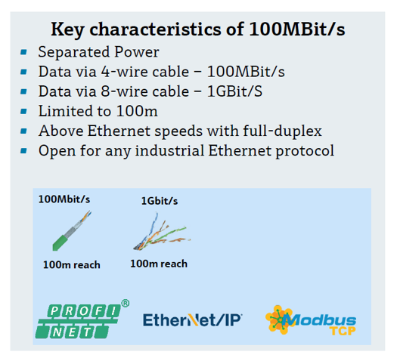
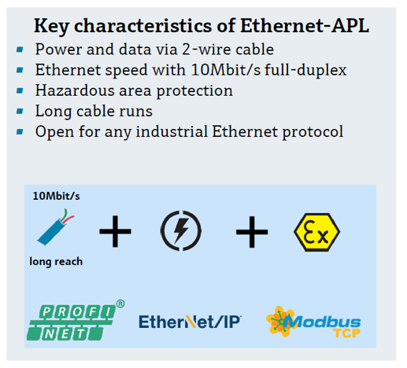
Conventional Ethernet v APL
Images – Endress+Hauser
PI UK – Glasgow 2023 – APL The Advanced Physical Layer

Slide 10
Comparisons with other Ethernet types
 | Industrial Ethernet | Ethernet APL | Single Pair Ethernet
Specifications | IEEE 802.3u / 100BASE-TX | IEEE 802.3cg-2019 - 10BASE-T1L
Hazardous Areas ? | NO | Explosion hazardous areas including intrinsic safety (via 2-WISE in IEC 60079-47) | NO
Power Concept | Separately Powered | APL Port Profiles (loop-powered or separately powered) up to 15 VDC and 0.5W | Power over Data Line (PoDL) acc. IEEE 802.3bu -up to 30 VDC and 8W
Connectors | RJ45 or M12 D-coded | Terminals or M12 A-coded | SPE connectors or M12 A-coded
Switches | Standard Switches | APL Field Switches | SPE Switches
Protocols | Industrial Ethernet real-time protocols, e.g. PROFINET, EtherNet/IP, Modbus TCP Standard Ethernet applications, e.g. http
PI UK – Glasgow 2023 – APL The Advanced Physical Layer

Slide 11
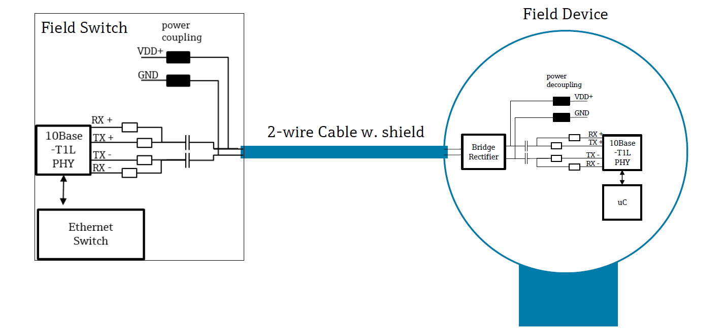
APL – 2-Wire / Full Duplex
Images – Endress+Hauser
PI UK – Glasgow 2023 – APL The Advanced Physical Layer

Slide 12
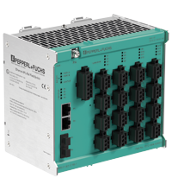
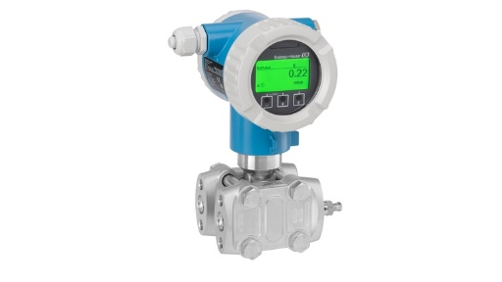



APL Support
APL devices are starting to appear from several global organisations.
A new PROFINET PA module has been added to the existing Certified PROFINET Engineer course
PI UK – Glasgow 2023 – APL The Advanced Physical Layer

Slide 13
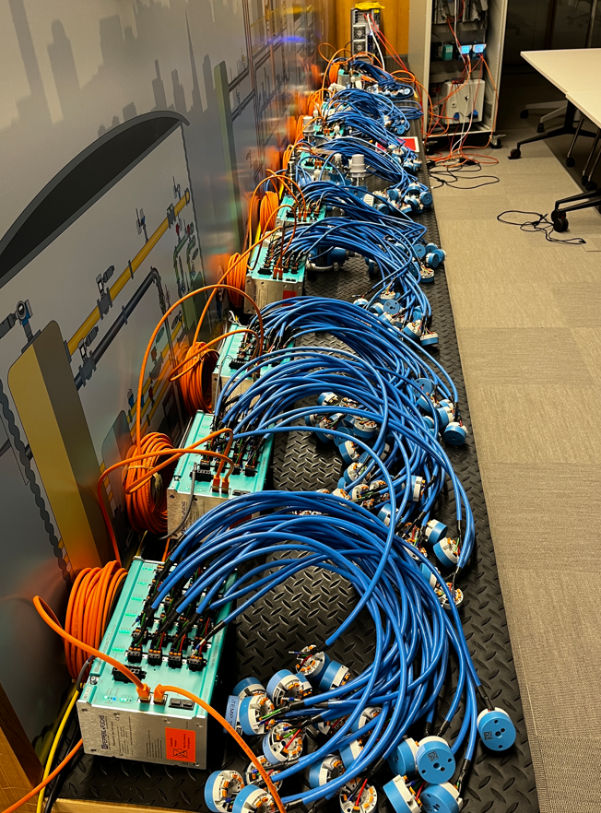
APL – Proven Technology
The first test was set up with nearly 240 Endress+Hauser measuring devices, including flow, pressure, temperature and level sensors.
They were integrated into a system with Pepperl+Fuchs’ field switches and a Honeywell control system, all using Ethernet-APL and PROFINET.
For the second test ABB provided the control system and was tested along with the previous field switches and measuring devices.
Images – Endress+Hauser
PI UK – Glasgow 2023 – APL The Advanced Physical Layer

Slide 14
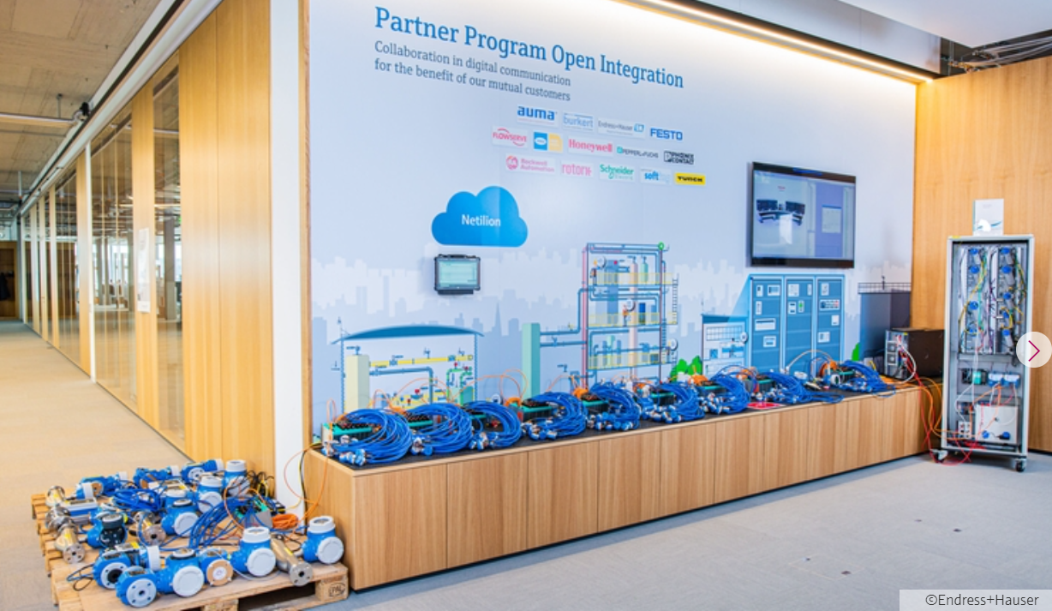
APL – Proven Technology
The test results were conclusive: Ethernet-APL can be used under realistic circumstances. The test cases were carried out with maximum network layout, and the scalability and fault tolerance were successfully verified.
All relevant requirements like total netload or redundancy switch-over times were met or exceeded.
PI UK – Glasgow 2023 – APL The Advanced Physical Layer

Slide 15

Case Study - BASF
The chemical company BASF have recently completed a proof on concept project using APL. The results of this are published on the Automation World web site: https://www.automationworld.com/
They set three clear objectives:-
To obtain additional data from the devices to allow a digital twin to be created.
To collect similar data from across its sites to provide a better insight into their operations and promote standardization in maintenance and remote overseeing of operations.
To aggregate the data overtime to allow correlations to be identified and optimisation to be improved.
PI UK – Glasgow 2023 – APL The Advanced Physical Layer

Slide 16
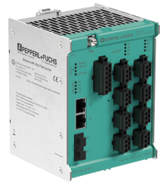
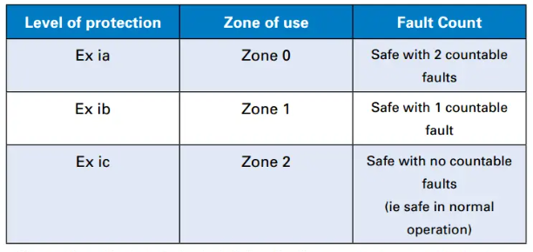
APL Switches (EX ic)
Powered spur ports intrinsically safe Ex ic according to 2-WISE and FISCO (11.6v, 95mA and 1.11W)
PROFINET MRP, S2 redundancy and dynamic reconfiguration
2 ports each for 1000BASE-T and SFP transceivers
Redundant power input 20 VDC ... 60 VDC
Installation in Zone 2
Physical layer diagnostics at the spur
Configuration and diagnosis with FDI, web interface, PROFINET device functions and SNMP
Support of network security
Support of Ethernet-APL and PROFIBUS PA instruments
PI UK – Glasgow 2023 – APL The Advanced Physical Layer

Slide 17
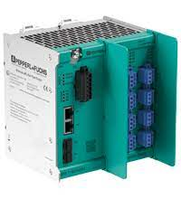
APL Switches (EX ia)
Powered spur ports intrinsically safe Ex ia according to 2-WISE and FISCO (9.6V, 55.56mA and 640mW)
PROFINET MRP, S2 redundancy and dynamic reconfiguration
2 ports each for 1000BASE-T and SFP transceivers
Redundant power input 20 VDC ... 60 VDC
Installation in Zone 2
Physical layer diagnostics at the spur
Configuration and diagnosis with FDI, web interface, PROFINET device functions and SNMP
Support of network security
Support of Ethernet-APL and PROFIBUS PA instruments
PI UK – Glasgow 2023 – APL The Advanced Physical Layer

Slide 18
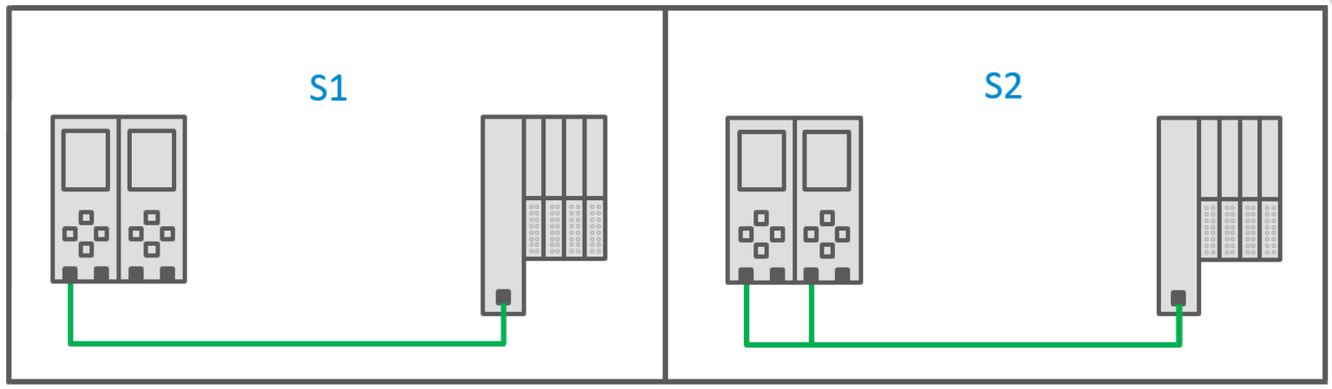
PROFINET S2 Redundancy
PI UK – Glasgow 2023 – APL The Advanced Physical Layer

Slide 19
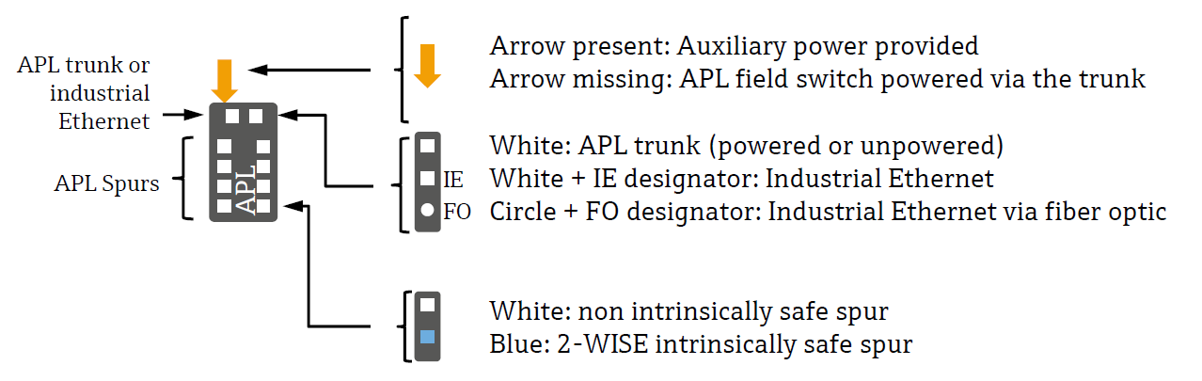
Typical Topologies (Symbols)
Engineering Guideline Ethernet-APL
PI UK – Glasgow 2023 – APL The Advanced Physical Layer

Slide 20
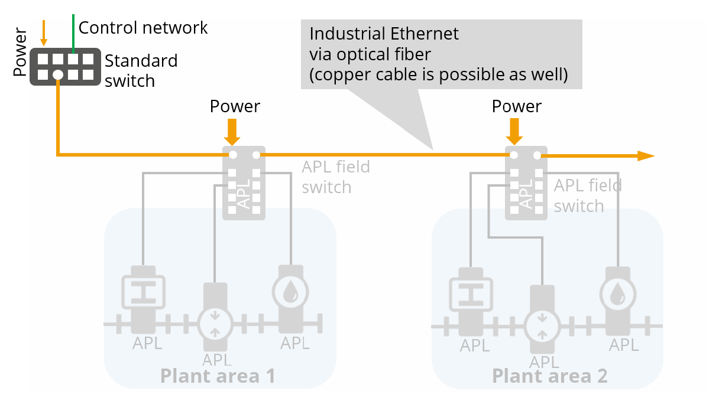
Typical Topologies (Ethernet Trunk)
Engineering Guideline Ethernet-APL
PI UK – Glasgow 2023 – APL The Advanced Physical Layer

Slide 21
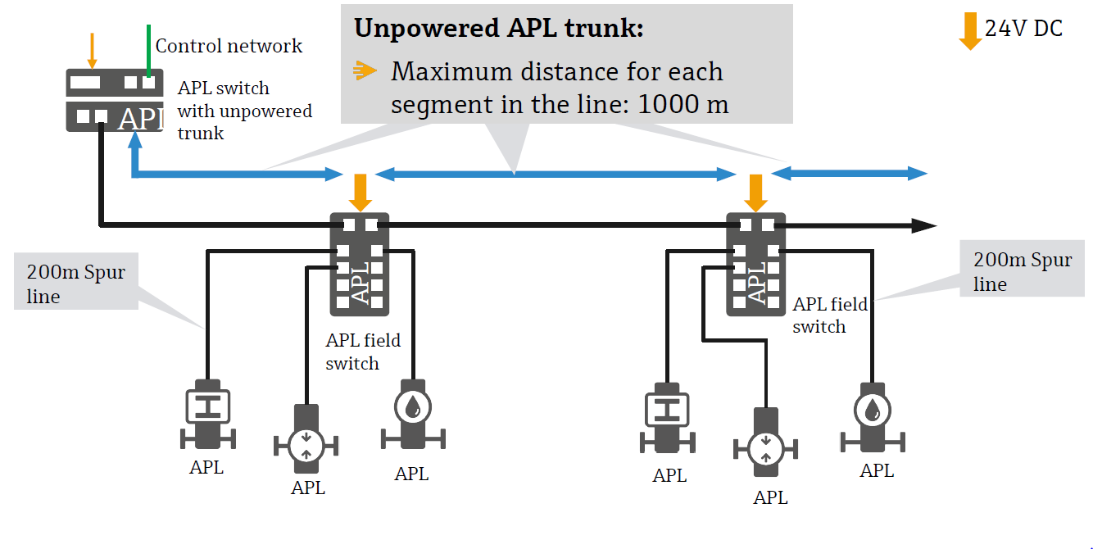
Typical Topologies (Unpowered Trunk)
Engineering Guideline Ethernet-APL
PI UK – Glasgow 2023 – APL The Advanced Physical Layer

Slide 22
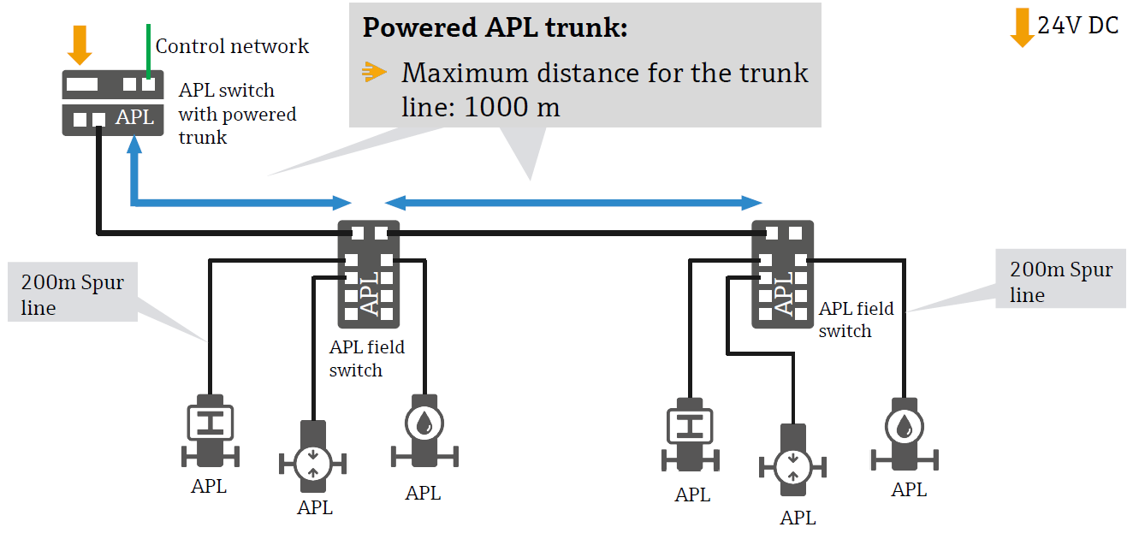
Typical Topologies (Powered Trunk)
Engineering Guideline Ethernet-APL
PI UK – Glasgow 2023 – APL The Advanced Physical Layer

Slide 23
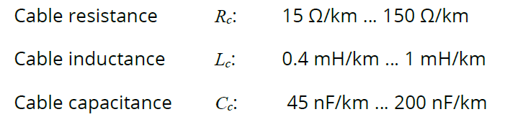
APL and Hazardous Areas
APL uses a concept called 2-WISE (2-Wire Intrinsically Safe Ethernet).
All used equipment must be certified according to 2-WISE.
The cable used to connect switch, field device and auxiliary device to a spur may be up to 200 m and must follow the following specification:
PI UK – Glasgow 2023 – APL The Advanced Physical Layer

Slide 24
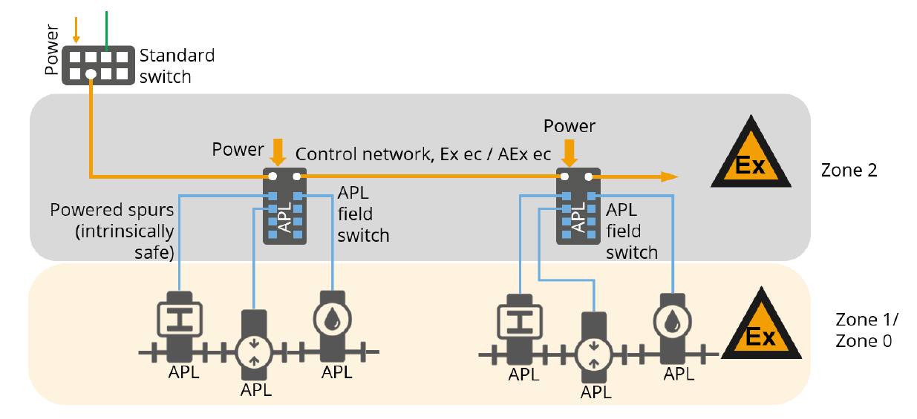
Spur topology with field switches installed in Zone 2
Engineering Guideline Ethernet-APL
PI UK – Glasgow 2023 – APL The Advanced Physical Layer

Slide 25
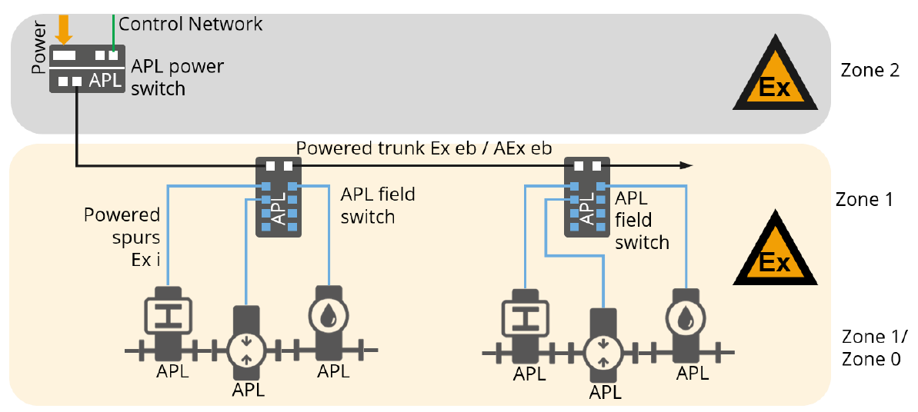
Spur topology with field switches installed in Zone 1
Engineering Guideline Ethernet-APL
PI UK – Glasgow 2023 – APL The Advanced Physical Layer

Slide 26
APL – Cyclic and Acyclic Data
The main function of an APL device is to accurately measure and relay its process value, e.g. temperature, pressure, flow etc.
These will used by the control system to control the various process using PID controllers.
PID control is a time-critical functionality and it is vital that the process variables are read on a regular / cyclic basis for the individual P, I and D terms to work correctly
The actual cycle period is a function of the natural speed of the process.
The main benefit of APL is the facilitation of access to large amounts of data that do not need to be read as often, this is called acyclic data.
PI UK – Glasgow 2023 – APL The Advanced Physical Layer

Slide 27

FDI and Access to Acyclic Data
FDI or Field Device Integration facilitates acyclic access to data in each process device.
It effectively combines the benefits of its predecessors Device Type Manager/Field Device Technology (DTM/FDT) and Electronic Device Description Language (EDDL)
FDI was jointly developed by leading process industry foundations including FieldComm Group, FDT Group, PROFIBUS & PROFINET International, and the OPC Foundation.
Major supplier companies including ABB, Emerson Process Management, Endress+Hauser, Honeywell, Schneider, Siemens, and Yokogawa supported the project with significant resources.
PI UK – Glasgow 2023 – APL The Advanced Physical Layer

Slide 28
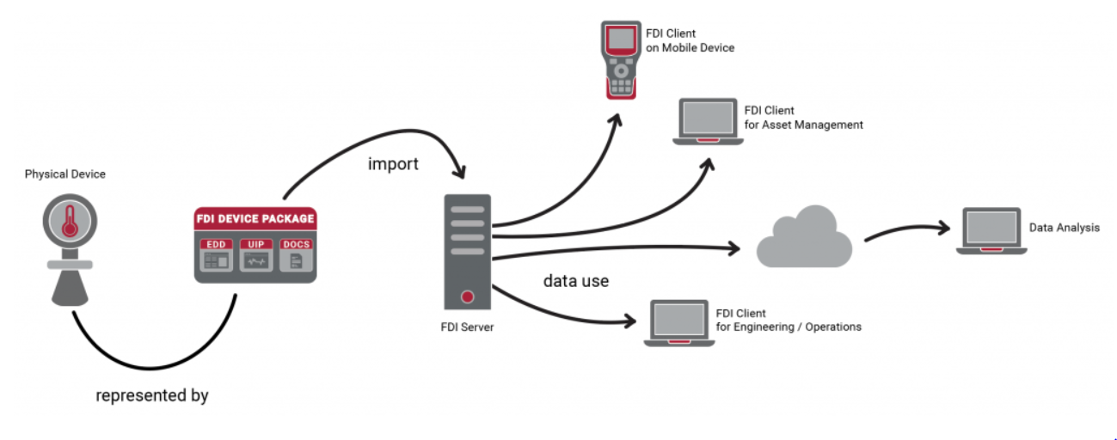
FDI Data Flow
PI UK – Glasgow 2023 – APL The Advanced Physical Layer

Slide 29
Questions
Peter Thomas
HMS Industrial Networks Ltd
PI Training Manager (MU North)
peth@hms-networks.com
PI UK – Glasgow 2023 – APL The Advanced Physical Layer

