Slide 1

Andrew Ellis – Product Manager - Automation Phoenix Contact UK
Public

Slide 2
Agenda
1
Introduction – Safety in Automation
2
The Situation for Manufacturers / Customers?
3
IO-Link
4
IO-Link Safety
5
What Happens Next
6
Further Information

Slide 3

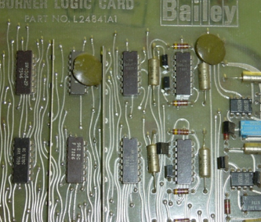
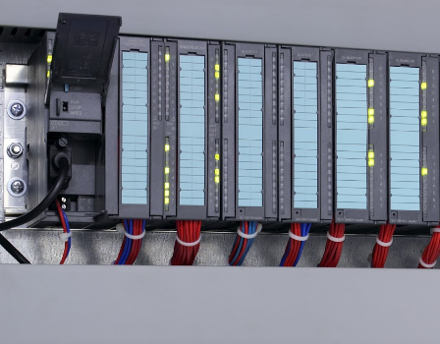
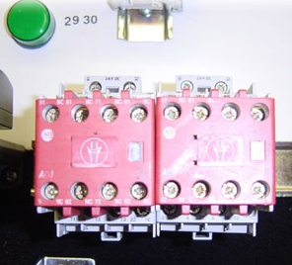
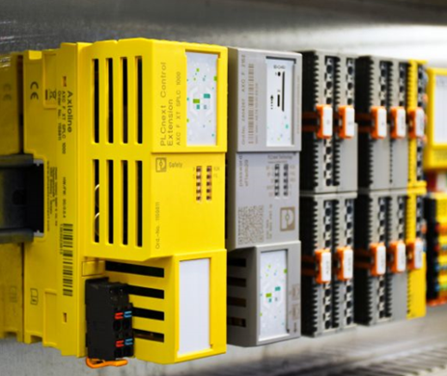
Introduction – Safety In Automation
Industrial Revolution
Electrical Revolution
Electronic Revolution

Slide 4






Introduction – Safety In Automation
FSCP 3
FSCP 6
FSCP 12
FSCP 1
FSCP 2
FSCP 14
FSCP 18
FSCP 13
Non-IEC "A"
FSCP 17
Non-IEC
"C"
FSCP 8
IEC 61784-3-x: Collection of FSCPs (Functional Safety Communication Profiles)
Notes:
Usually, IO-Link Safety will be a companion technology to upper level safety systems such as safety fieldbuses.
The safety communications of such fieldbuses is standardized within IEC 61784-3 series as FSCPs.
FSCP1: FF-SIS → Foundation Fieldbus Safety Instrumented Systems
FSCP2: CIP Safety → Ethernet IP (ODVA)
FSCP3: PROFIsafe → PROFINET, PROFIBUS (PNO)
FSCP6: Interbus Safety
FSCP8: CC-Link Safety
FSCP12: Functional Safety over EtherCat (FSoE)
FSCP13: Powerlink Safety
FSCP14: EPA Safety
FSCP17: RAPInet Safety
FSCP18: SafetyNet_p
NonIEC A: AS-i Safety at Work
NonIEC C: CANopen Safety

Slide 5
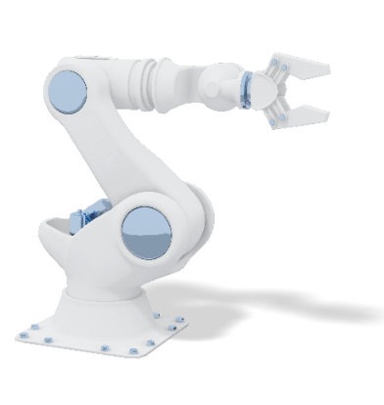

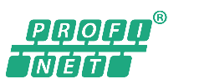
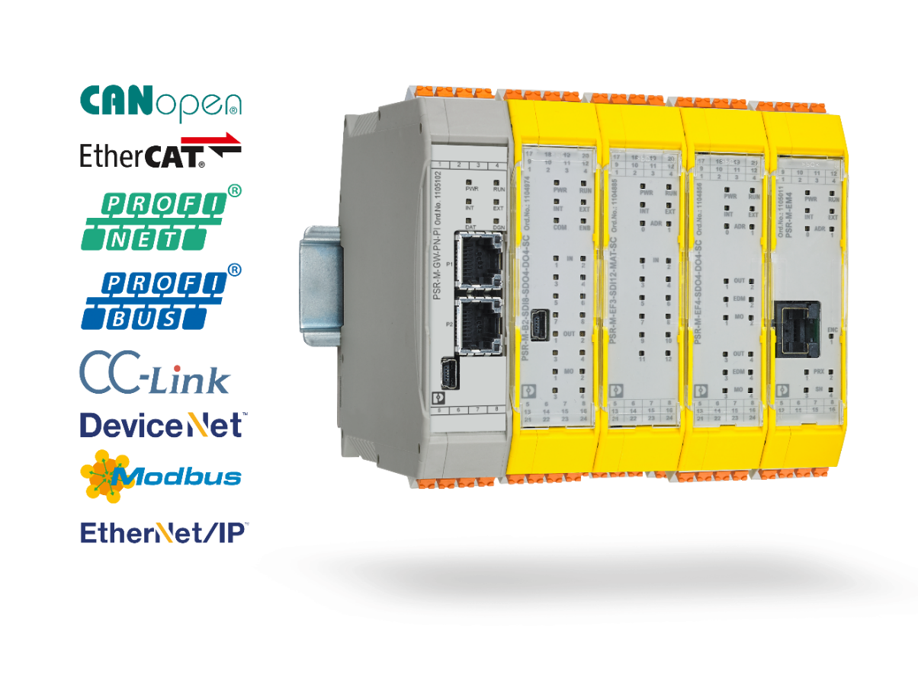


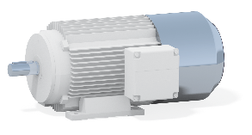
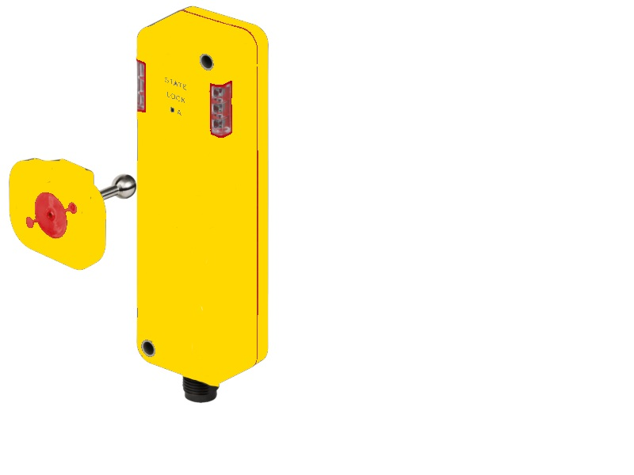
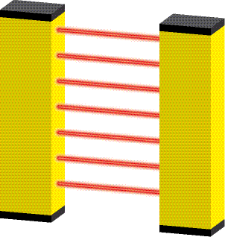

The Situation for Manufacturers
FSoE - Host
Cip Safety Scanner
PROFIsafe Controller
Fieldbus & Functional Safety Communication Profile
Remote I/O with FS modules
More or less standardized interfaces

Slide 6

The Situation for Customers
Machine builder decides on type of fieldbus to be used depending on deployment case
Thus, specific devices for each fieldbus with separate spares inventory, version maintenance and service are required
Thus, high degree of persistence to stay with "classic" interfaces such as OSSD, 4 to 20 mA, and etc. on "remote IO" field devices, since they are independent from fieldbus

Slide 7
The Situation for Customers
However: no connection to Internet-of-Things (IoT) and Industry 4.0
Numerous new applications: (see "Smart Manufacturing") - New sensor technologies, e.g. strain, torque, pressure, multi-sensing, and etc. - More measuring sensors, e.g. object types, distance - Mechatronics, e.g. combinations sensors/actuators
Progressive miniaturization

Slide 8
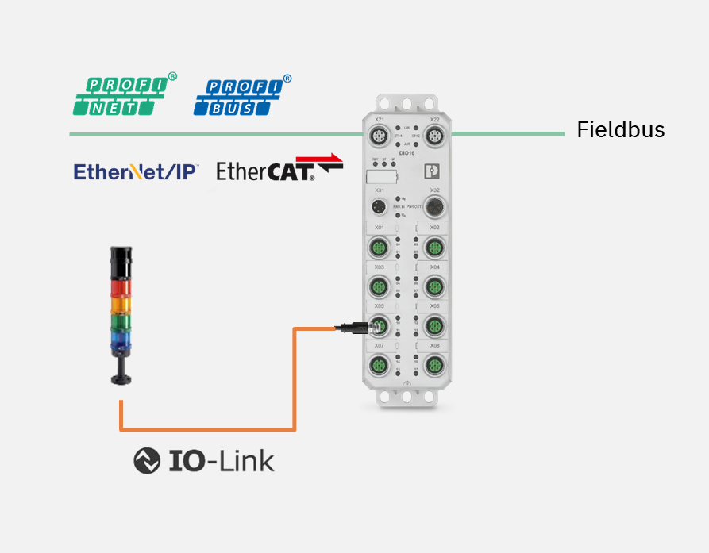
IO Link
How is this issue solved in automation?
Standard Sensor / Actuator Communications profile independent of the fieldbus
Point – Point Communication
Standard IO support through hardware support
IO-Link

Slide 9
IO Link -Standardisation
Class A (Device)
2
I/Q
Master
Standard Hardware configuration
Power, IO, Communications
Function Parameterised in IO-Link Master
IO-Link Sensor / Actuator
Standard Connection
Functionality / setup defined in a standardised IODD file for IO-Link Master software
Setup of IO-Link device can be checked and stored in IO-Link master or controller.
2
1
Power 1 power supply
1
4
C/Q
3
3
4
5
Isolated from Power 1
M12-4
2
P24 (Actuator)
Master
Power 2 extra power supply
Class B (Device)
2
1
Power 1 power supply
1
4
C/Q
3
5
3
4
5
M12-5
N24 (Actuator)
Notes:
Power supply and signal options:
Port Class A with Power 1 (maximum of 1000 mA @ IO-Link Safety!)
Port Class B with extra Power 2, depending on type of connector ≥ 3,5 A and wire gauges
Power 1 electrically isolated from Power 2
Port Class B shall be marked since pin layout is not compatible with Class A

Slide 10

IO Link - Benefits
Wiring & Power supply
(IO-Link)
COM + 24 V
New
Standard M12
One Sensor / Actuator device for World Market
Benefits of IO-Link
Sensor / Actuator Replacement w/o Tools
On/Off-site Parameterization & Test (IODD)
Detection of Misconnection
Communication, bidirectional

Slide 11
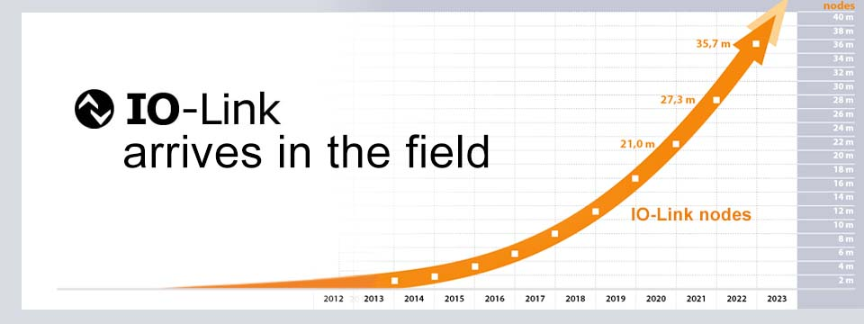
IO Link – Real World Benefits
More than 420 member
Companies worldwide

Slide 12

Yes!
Can this be extended to cover Safety?

Slide 13

IO Link
L+
Switching signal ("SIO")
1
SIO
C/Q
2
4
I/Q
3
COMx
4,8 / 38,4 / 230,4 kbit/s
IO-Link communication
L-
"Coded Switching"
Notes:
Power and signals compliant with IEC 61131-2
Dual mode standard Devices: SIO (Standard Input Output) or IO-Link Communication (migration strategy)
SIO means traditional "switching signals"
IOL communication means "coded switching signals"
Three transmission rates: COM1 = 4,8; COM2 = 38,4; COM3 = 230,4 kbit/s
Pin layout corresponds to IEC 60947-5-2

Slide 14
IO Link Safety
IOL-OSSDe
OFF state
Testpulses
IOL-OSSDe: Equivalent signals
L+
OFF state
1
IOL-OSSDe
C/Q
2
4
I/Q
3
COMx
4,8 / 38,4 / 230,4 kbit/s
IO-Link Safety communication
L-
OSSD: Output Switching Sensing Devices (Solid state outputs)
OSSDe: = OSSD with equivalent switching signals; type C, class 1 according to Position Paper CB24I (ZVEI)
Notes:
Same as SIO and IO-Link communication
Pin layout corresponds to AIDA position paper
Safety: Dual mode FS-Devices: OSSDe (default) or IO-Link Safety communication
"e" stands for equivalent switching redundant signals
FS-Device output sends and reads back short test pulses for error detection
IO-Link Safety uses the I/Q signal line (Pin 2) for OSSDe operation (OSSD2e)
The German Car Manufacturers Association (AIDA) requires the same pin layout as IO-Link Safety.

Slide 15
IO Link Safety To Fieldbus Level
PROFIsafe development kit
PROFIsafe services + Protocol state machine
PROFINET
PROFIsafe
Gateway: PROFINET IO-Link Integration ("Linking Modules")
PROFIsafe
FS-IO mapping
PROFIsafe ‒ IO-Link Safety Gateway
IO-Link Safety (COM)
FS-DI (OSSDe)
IO-Link Safety services + Protocol state machine
Standardized Master Interface (SMI)
Configuration Manager
(Parameter) Data Storage
Acyclic Data Exchange
Diagnosis Unit
Splitter/Composer
IO-Link Safety
Cyclic Process Data Exchange
Master layers
FS-Device
Notes:
Safety integration is a linear extension of the fieldbus integration. Usually, there exist development kits for particular FSCPs such as PROFIsafe.
In case of SIL3 applications, these development kits recommend redundant microcontrollers to carry the FSCP protocol firmware.
IO-Link Safety fits well into this approach since it can be implemented totally hardware independent.
This figure shows also the "black channel" character of the FS-Master. The core part is a standard non-safety IO-Link Master with two modifications:
An FS-Master Port is able to sense the "READY" pulse of an FS-Device
An FS-Master is able to split the SPDU (safety protocol data unit) from the entire IO-Link message. In contrast, an FS-Master is able to compose an entire IO-Link message out of an SPDU and a non-safety data part.

Slide 16
IO Link
How is this issue solved in automation?
Standard Hardware Interface
Standard Sensor / Actuator Communications profile independent of the fieldbus
Point – Point Communication
Standard IO support through hardware support
IO-Link

Slide 17
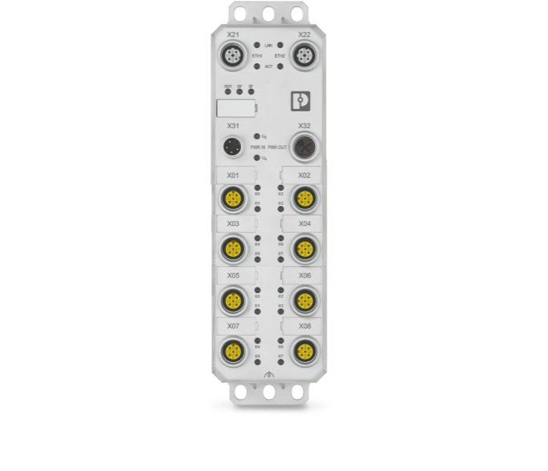

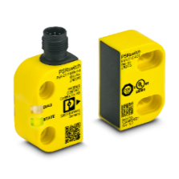
IO Link Safety
Standard Safety Devices for next generation systems!
Standard Safe Hardware Interface
Standard Safety Communications profile independent of the fieldbus
Point – Point Communication
Safe IO support through hardware support
Safety Protocol
IO-Link Safety

Slide 18
IO Link - Benefits
Wiring & Power supply
(IO-Link)
COM + 24 V
New
Standard M12
One Sensor / Actuator device for World Market
Benefits of IO-Link
Sensor / Actuator Replacement w/o Tools
On/Off-site Parameterization & Test (IODD)
Detection of Misconnection
Communication, bidirectional

Slide 19
IO Link Safety - Benefits
Wiring & Power supply
(IO-Link)
COM + 24 V
New
Standard M12 for Safe Devices
One Safe device for World Market
Benefits of IO-Link
Safe Device Replacement w/o Tools
On/Off-site Parameterization & Test of Safe Devices (IODD) - PLe
Detection of Misconnection (Safe channels & Devices)
Safe Communication, bidirectional

Slide 20

IO Link Safety - Summary
Fieldbus with one of the FSCPs (IEC 61784-3)
Compact FS-Master (IP65)
Remote I/O
AI
AO
DI
DO
FS-Master
0
0
0
0
0
0
0
4
6
7
7
7
7
7
3
7
0 to 10 V
0 to 24 V
PM switching
IO-Link Safety
IO-Link
Analog
measure-
ments
Switches
Relays
Digitized
measure-
ments
OSSDe
or
COM
Low voltage switch
gear
Drives with safety
Non safety
Device
Notes:
Effect here is the same as with standard IO-Link. Instead of several different modules within a remote I/O such as FS-DI, FS-DO, FS-AI, and FS-AO, the user can focus on one FS-Master and save space, invest, and spares inventory .
Long lasting discussions for product managers about the number of channel types (how many FS-DI? FS-DO? FS-AI? Etc.) in compact devices can be alleviated → Just use a compact FS-Master with uniform Ports instead. They universally can be used for non-safety operation (DI, DO, COM) or safety operation (OSSDe, Safety COM).
Various different module interface technologies (OSSD, 0 to 10 V, 4 to 20 mA, etc.) become more and more obsolete.

Slide 21
What Happens Next?
IO-Link Safety Standard is complete
First Workshop to certify the first IO-Link Safety Designers was run in May
Development and Test Tools are now available
Certification process has been formalised.
First Commerical IO-Link Safety Master and Devices to be demonstrated at end of 2023

Slide 22






















What Happens Next?

Slide 23
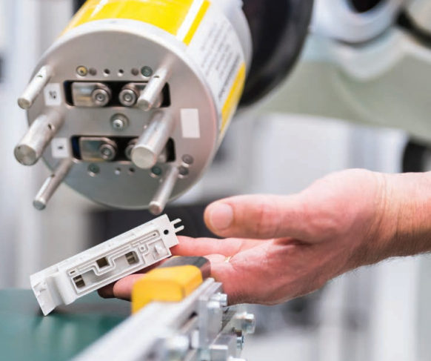
Further Information
https://io-link.com/
https://www.profibus.com/
UNITED KINGDOM - uk.profibus.com
Also further information will be available through supporting Automation Vendors and Manufacturers

Slide 24
Any Questions?

